Slide 1
Using MyMathLab to Succeed!
General Tips and Strategy
Click here!
AccessAbility Services
Higgins Annex, Room 017
(203) 837-8225

Slide 2
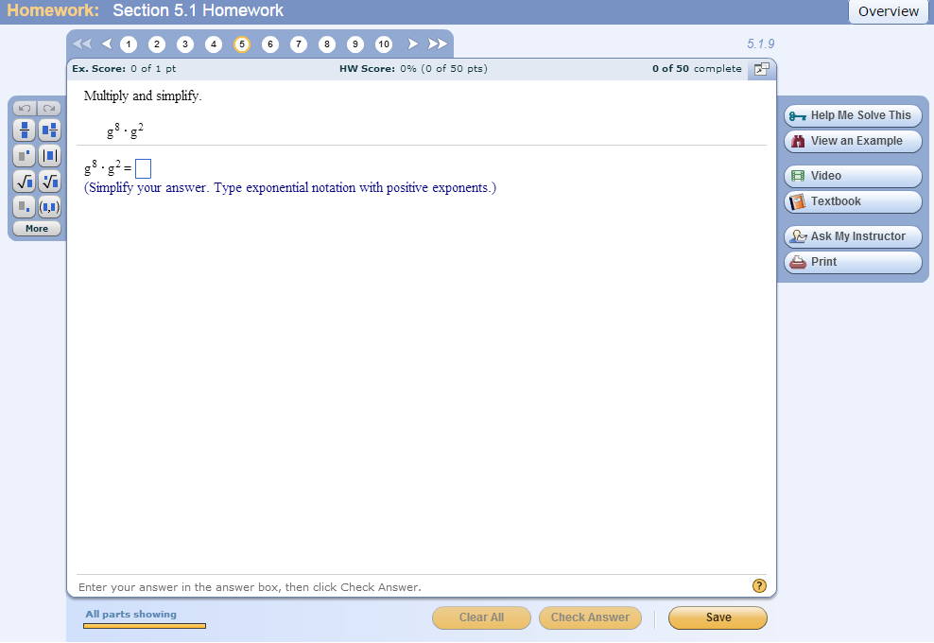
The Interface
Directions
“Purple Directions”
How you type in technical math symbols
“Help Buttons”

Slide 3
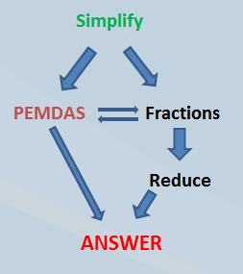
Common Directions: Simplify
Simplify: Use PEMDAS to make it look different
Parenthesis?
Do the stuff inside, if possible!
Distribute (Multiply) to remove them!
FOIL to remove them!
Exponents? Use them!
●, Multiply!
÷, Divide, if possible! Keep it a fraction, unless it tells you to use a decimal!
+, Add, if possible!
—, Subtract, if possible!

Slide 4
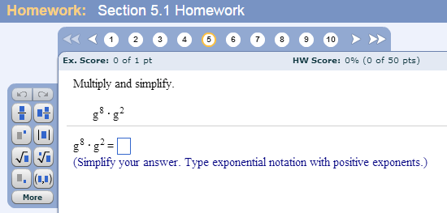
“Purple Directions”
Carefully follow these directions!
This is where it will tell you to use decimals, instead of fractions, and provide any special directions.
Sometimes this instruction hints as to how to tackle the problem!

Slide 5
No “Purple Directions”?
When there are no purple directions,
MyMathLab wants integers or reduced fractions, not decimals!
If a problem uses decimals and your answer is a decimal, do not round unless told to do so by MyMathLab! Type in all the digits!
MyMathLab wants the answer fully simplified, combine as many like terms as possible!

Slide 6
If You Get a Problem Wrong…
You’ll see a red box like this pop up. Read it carefully because it sometimes hints as to why you got it wrong!
Sometimes an answer you find IS correct and you simply just need to type the answer differently in order for MyMathLab to read it as correct! This box aims to help you do just that!

Slide 7
Buy a Cheap Calculator
These TWO LINE scientific calculators DO FRACTIONS FOR YOU! (Yes, they’re allowed.)
You’ll thank yourself for buying one after chapter 9 - hint hint!
If you need help using its cool functions like fractions, etc, ask for help!

Slide 8
Summary
Always read every line of text MyMathLab offers. It was chosen for a reason!
Challenge yourself to understand the wording used.
When you have questions, use your resources!
Visit the Math Clinic in Higgins Hall 204
Visit the Tutoring Resource Center in Berkshire 104
Ask a T A!
Ask your instructor!
Ask a tutor!
Check Google!
Check out KhanAcademy.org, MathIsFun.com, etc

