Slide 1
Purchasing and Contracting Policies and Procedures
OVERVIEW
June 2020

Slide 2
Comprehensive Procurement Manual
Manual developed and maintained by representatives of the (17) CSCU schools and the System Office.
CSCU System-wide manual.
The purpose of the manual is to is intended to explain and facilitate the processes, procedures, and regulations associated with the acquisition of products and services for Western Connecticut State University. The Purchasing Manual can be found
within the purchasing area of the University’s website.

Slide 3
Purchasing Overview
The acquisition process is dynamic and complex in nature and greatly influenced by a wide range of variables and events both internal and external to the University.

Slide 4
Purchasing Department
Part of the Administrative Services Department
  Karen Muffatti: Purchasing Assistant
  Mark Case: Director – Administrative Services (Contracts/PSA’s/Honorarium)

Slide 5
Structure of the Overview
Section I: General Purchasing Overview
Section II: Purchase Orders
Section III: Personal Service Agreements
Section IV: CSUS2020 Bond Funds
Section V: Purchasing Cards
Section VI: Glossary, Appendices and Exhibits

Slide 6
Section I: General Purchasing Overview
Details include the following:
  Role of the Purchasing Department.
  Definition of bidding procedures and thresholds.
  Overview of regulations concerning agency administered Department of Construction Services projects and CHEFA projects and 2020 equipment

Slide 7
BID THRESHOLD LEVELS
Dollar Threshold | Process
Acquisitions < $10K | Formal competitive public sealed bidding not required.
Acquisitions > $10K - <$49,999.99 | Purchases shall be made in the open market and, when possible, be based on at least three written quotations or bids from responsible and qualified sources of supply.
Acquisitions > $10K - <$49,999.99 | Formal competitive sealed bidding required. Bid to be posted publicly on the Department of Administrative Service’s Bid Portal.

Slide 8
Exceptions to the Bidding Process
Sealed bidding is not required when:
  Product or service is obtained via available standing contracts such as:
    Department of Administrative Services (DAS)
    Connecticut State Colleges & Universities (CSCU)
    University of Connecticut (UCONN) (If no existing DAS contract is available)
    Connecticut College Purchasing Group (CCPG- Public Institutions)
    Federal GSA contracts (CGS 4a-53 (b)
    Consortiums- Massachusetts Higher Ed. Consortium(MHEC),
    E and I (Educational and Institutional), TCPN, NJPA, US Communities
    Or when the product or service is determined to be a “Sole Source”
    Note: WCSU Purchasing Department reserves the right to competitively bid a product/service instead of utilizing a standing contract if competitively bidding the requirement is in the best interests of the University.

Slide 9
Department of Construction Services (DCS) Projects
Agencies currently authorized through DCS to administer up to $2M/project for campus improvements.
While DCS acquisition regulations and criteria are utilized for DCS projects administered by the University, CSCU bid threshold guidelines prevail for University administered DCS projects.
Any DCS related project is coordinated through the University’s Planning and Engineering office.
Similar guidelines prevail for CHEFA (Connecticut Health and Education Facilities Authority) projects.
Any renovation or furnishing requirements must be routed through the Planning and Engineering Office.

Slide 10
Section II – Purchase Orders
Defines Purchase Requisition creation.
Details Purchase Order creation.
Identifies a process to request a change to the Purchase Order.

Slide 11
Purchase Requisition
The Purchase Requisition initiates the Purchasing process.
Key components:
  Prospective vendor(s)
  Price (if available)
  Department and Banner charge number
  Authorized Signature (Budget Authority)
  Items ordered
  Contract or Bid Award Number if applicable
  Note: A fillable pdf requisition form is available through the University’s Purchasing website.

Slide 12
Purchase Orders
Purchase Orders are created by the Purchasing Department via the banner system.
Only the Purchasing Department can create a Purchase Order.
Orders created from the purchase requisitions received from campus personnel.
Purchasing Department reserves the right to reject requisitions or perform further bidding activity if deemed in the best interests of the University.

Slide 13
Types of Purchase Orders
Regular (Product)
CHEFA/2020
Service
Emergency
Notes on Emergency Orders:
An emergency is defined as a situation where the normal operation or portion thereof of WCSU would cease or be seriously impaired if immediate action was not undertaken to correct the contingency.
Any emergency situation must be declared as such by the VP for Finance and Administration.

Slide 14
Section III – Personal Service Agreements
Defined as an agreement which covers services by a corporation, partnership, or individual of a technical or professional nature (ie; athletes, entertainers, consultants, etc).
Different from a Purchase Order in development and authority.

Slide 15
Key Points – Personal Service Agreements
PSA’s with a value of $25,000 or above must be forwarded to the State of Connecticut’s Attorney General’s Office for approval.
The honorarium form can be used for services less than $3,000.
Note: All PSA’s and honorariums must be forwarded to the Administrative Services Office prior to start of services.
Note: All PSA’s, Honorariums, and Contracts must be signed by the VP for Finance and Administration or an authorized signatory.

Slide 16
Key Points – Personal Service Agreements
State employees may not execute a contract with a relative (as defined in the manual). Such action may be in violation of the State Code of Ethics.
PSA’s may not be used to contract with any individual, corporation, or other business entity in which the requester may have a financial interest.
In accordance with C.G.S. 1-84(i), a State employee and his/her immediate family are prohibited from entering into contracts with the State with a value of $100 or more unless the contract has been awarded through an open and public process.
The PSA must clearly reflect reimbursement for travel expenses (as required). The University’s travel manual shall offer guidance and policies for reimbursing contractors for travel expenses.

Slide 17
Section IV: CSUS 2020 Bond Funds
Section 10a-91d(f) of the C.G.S requires approval for any purchase of equipment, furniture or personal property using CSCU 2020 funds. All initial requests must be sent to your Chair/Dean or VP for approvals.
Approved acquisition requests must be sent to Fiscal Affairs using a CSUS-EQUIP-1 form. A quote from the supplier that includes all costs and shipping /handling information must be included with the form.
The request is then sent to the systems office for final approval. This approval process takes a minimum of 30 days. Once the systems office has approved the request, the funds are forwarded to the University. Fiscal Affairs will request the final requisitions from the department, and forward all the paperwork for final purchase order processing.

Slide 18
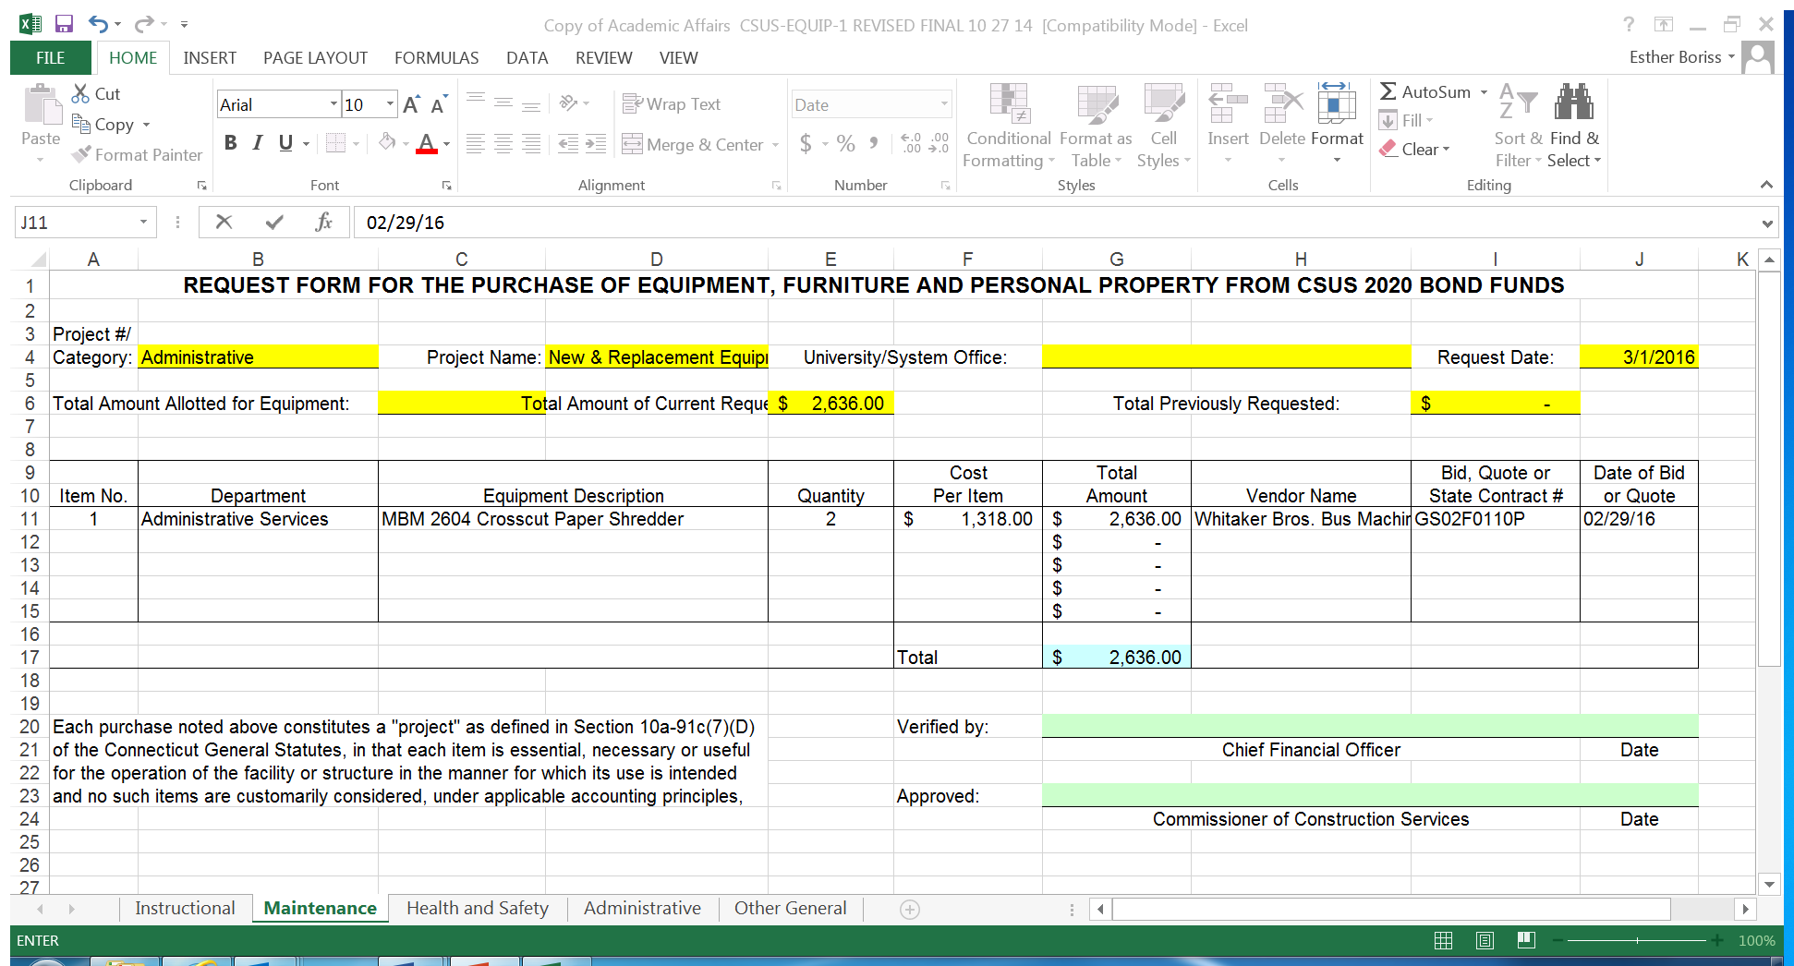

Slide 19
SECTION V: PURCHASING CARDS
The University has implemented a Purchasing Card (P-Card) program.
Currently there are approximately (150) active cards.
Designed to support product and service acquisitions valued at less than $2500.00.
Purchasing Office retains generic P-Cards for the acquisition of low dollar goods from local establishments or on-line purchases.
One on One training is available

Slide 20
Section VI: Glossary, Appendices and Exhibits
Provides definitions of key purchasing terms.
Detailing of CGS 10a-151b.
Defines the CSU System Wide Information Technology Protocol Program.
Identifies Resolutions issued by the CSU Board of Trustees/Board of Regents pertaining to Purchasing procedures and contract approval.

Slide 21
Key Purchasing Terms
Includes:
  Equipment: An article retaining a useful life of at least (1) year and a value of at least $5K. Supply budget money cannot be used to acquire an item defined as equipment.
  Budget Authority: Person designated as having responsibility of the funds for the department, cost center, grant, or their designee.
  Encumbrance: Reservation of funds for a particular purchase. Funds are considered encumbered when a Purchase Order is created in the Banner System.

Slide 22
CGS 10a-151b
Connecticut General Statute 10a-151b which provides acquisition authority for the University.
As a State Agency, the University is governed by this statute in terms of its acquisition processes.

Slide 23
Information Technology (IT Protocol Program)
CSCU has opted to consolidate some purchasing for the entire system, primarily in the area of information technology (hardware, software, etc) to realize economies of scale.
For all procurements estimated at or above $10,000, CSCU CIO decides if System Office Purchasing or University Purchasing executes and manages the acquisition.
Note: Requests for hardware or software regardless of dollar value must be forwarded to and approved by University Computing at WCSU.

Slide 24
Board of Regents
Resolutions issued by the Board of Regents are to be adhered to by the CSCU schools.
Resolutions include:
  Granting of Purchasing authority
  Contract signatory levels

Slide 25
Department Budgets
Budgets are tracked and managed through the Banner system.
For acquisitions to occur, appropriate fund must be identified with monies available.
Banner training is available; please contact Pete Rosa in fiscal affairs at 7-8376.

Slide 26
Audits
The University is subject to audits by a number of organizations, including:
  Auditors of Public Accounts (State of CT Auditors)
  Blum Shapiro (Private Auditing Company)
  Connecticut State Colleges & Universities (CSCU) System Auditors
  Most Common Finding: Late submittal of requisitions and honoraria. Creates inefficiencies and audit findings for the University.
  Key Point: Requisitions, honoraria, and accompanying paperwork must be submitted in a timely fashion.

Slide 27
Summary
The acquisition process is dynamic and complex in nature and greatly influenced by a wide range of variables and events both internal and external to the University.
This manual is a “living document” and is subject to revision and amendment.
This training is meant to provide an overview; please read the manual for further details on policies and procedures.
Questions? Contact:
  Karen Muffatti (ph. 7-8660)
  Mark Case (ph. 7-8657)

